Slide 1
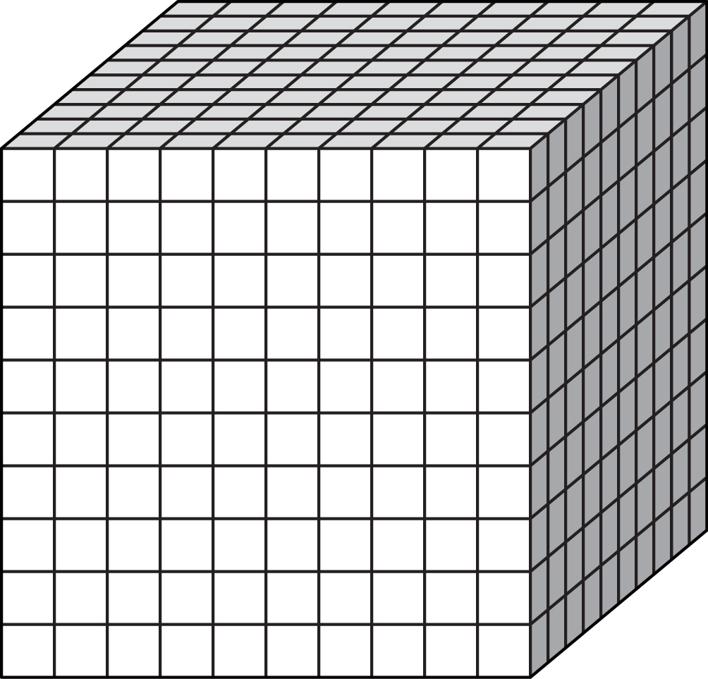
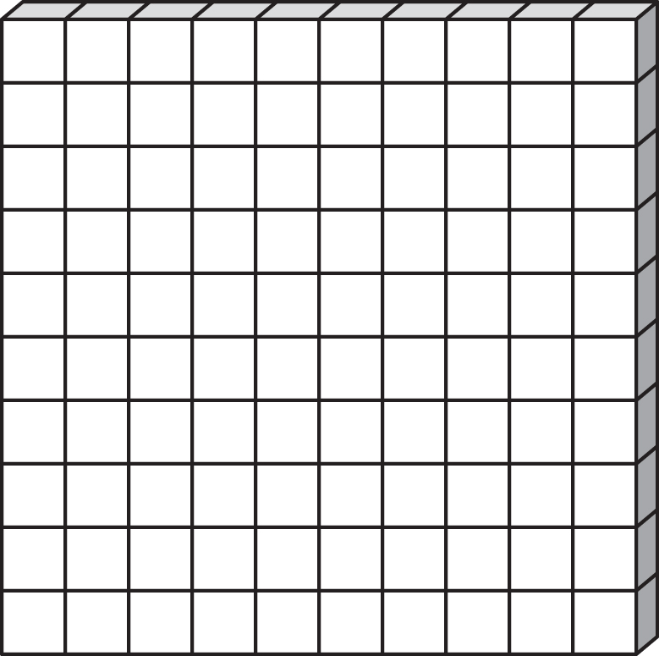
Equally separate each of the numbers show into the boxes provided.

Slide 2
Equally separate each of the numbers show into the boxes provided.

Slide 3
Equally separate each of the numbers show into the boxes provided.

Slide 4
Equally separate each of the numbers show into the boxes provided.

Slide 5
Equally separate each of the numbers show into the boxes provided.

Slide 6
Equally separate each of the numbers show into the boxes provided.

Slide 7
Equally separate each of the numbers show into the boxes provided.

Slide 8
Equally separate each of the numbers show into the boxes provided.

Slide 9
Equally separate each of the numbers show into the boxes provided.

Slide 10
Equally separate each of the numbers show into the boxes provided.

Slide 11
Equally separate each of the numbers show into the boxes provided.

Slide 12
Equally separate each of the numbers show into the boxes provided.

Slide 13
Equally separate each of the numbers show into the boxes provided.

Slide 14
Equally separate each of the numbers show into the boxes provided.

Slide 15
Equally separate each of the numbers show into the boxes provided.

Slide 16
Equally separate each of the numbers show into the boxes provided.

Slide 17
Equally separate each of the numbers show into the boxes provided.

Slide 18
Equally separate each of the numbers show into the boxes provided.

Slide 19
Equally separate each of the numbers show into the boxes provided.

Slide 20
Equally separate each of the numbers show into the boxes provided.

