Slide 1
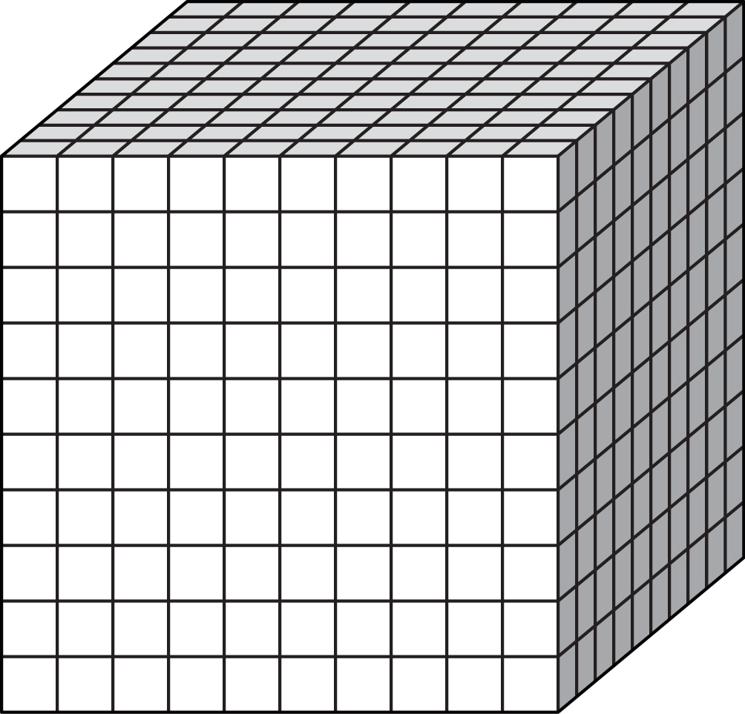
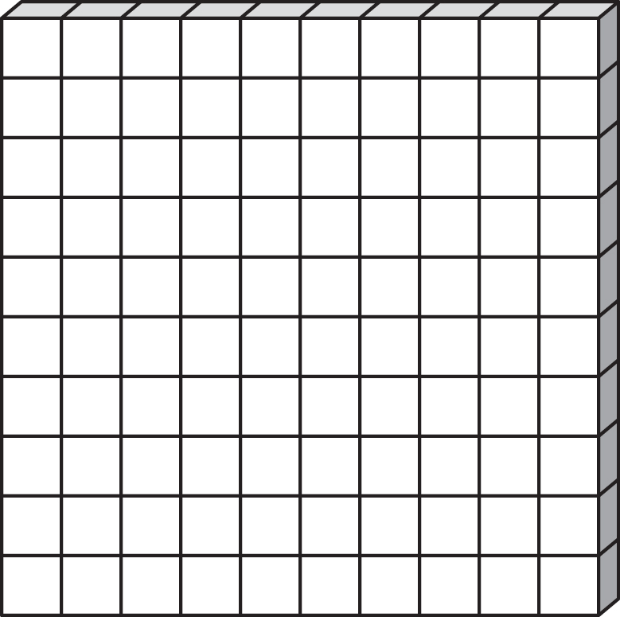
Equally separate each of the numbers show into the boxes provided. Put any remainders in the circle
Remainder

Slide 2
Equally separate each of the numbers show into the boxes provided. Put any remainders in the circle
Remainder

Slide 3
Equally separate each of the numbers show into the boxes provided. Put any remainders in the circle
Remainder

Slide 4
Equally separate each of the numbers show into the boxes provided. Put any remainders in the circle
Remainder

Slide 5
Equally separate each of the numbers show into the boxes provided. Put any remainders in the circle
Remainder

Slide 6
Equally separate each of the numbers show into the boxes provided. Put any remainders in the circle
Remainder

Slide 7
Equally separate each of the numbers show into the boxes provided. Put any remainders in the circle
Remainder

Slide 8
Equally separate each of the numbers show into the boxes provided. Put any remainders in the circle
Remainder

Slide 9
Equally separate each of the numbers show into the boxes provided. Put any remainders in the circle
Remainder

Slide 10
Equally separate each of the numbers show into the boxes provided. Put any remainders in the circle
Remainder

Slide 11
Equally separate each of the numbers show into the boxes provided. Put any remainders in the circle
Remainder

Slide 12
Equally separate each of the numbers show into the boxes provided. Put any remainders in the circle
Remainder

Slide 13
Equally separate each of the numbers show into the boxes provided. Put any remainders in the circle
Remainder

Slide 14
Equally separate each of the numbers show into the boxes provided. Put any remainders in the circle
Remainder

Slide 15
Equally separate each of the numbers show into the boxes provided. Put any remainders in the circle
Remainder

Slide 16
Equally separate each of the numbers show into the boxes provided. Put any remainders in the circle
Remainder

Slide 17
Equally separate each of the numbers show into the boxes provided. Put any remainders in the circle
Remainder

Slide 18
Equally separate each of the numbers show into the boxes provided. Put any remainders in the circle
Remainder

Slide 19
Equally separate each of the numbers show into the boxes provided. Put any remainders in the circle
Remainder

Slide 20
Equally separate each of the numbers show into the boxes provided. Put any remainders in the circle
Remainder

